Slide 1
EEG decoding of a bistable auditory percept
Adam Luoma and Sean McWeeny

Slide 2
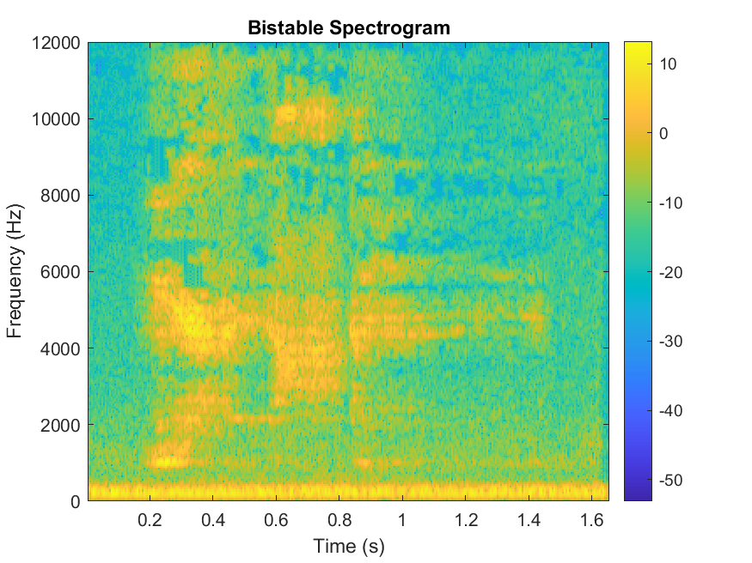

Bistable Percept

Slide 3
Unpacking bistable processing
Top-down process guiding perception
Some semantic priors/priming
Audio visual integration
When presented visual stimulus (e.g. text, images)

Slide 4
Why does it matter
Hearing aids produce degraded audio
Understanding how the brain makes sense of ambiguous inputs
BCI for speech production
Can we pull semantic information from primed EEG
Audio visual integration
When is integration occurring for semantics

Slide 5
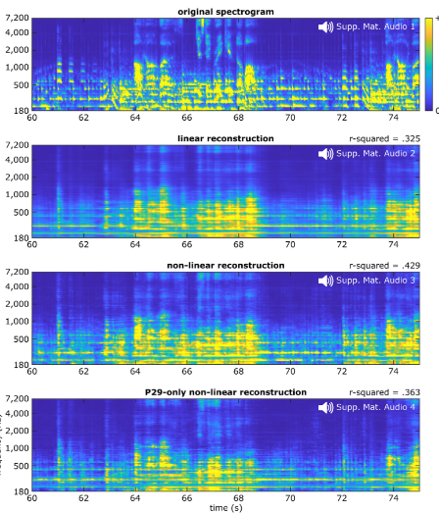
What is Decoding
Using brain data (e.g. EEG, MEG, fMRI) to decipher and reconstruct signals picked up by sensory systems
Figure (Beillier et al. 2023)

Slide 6
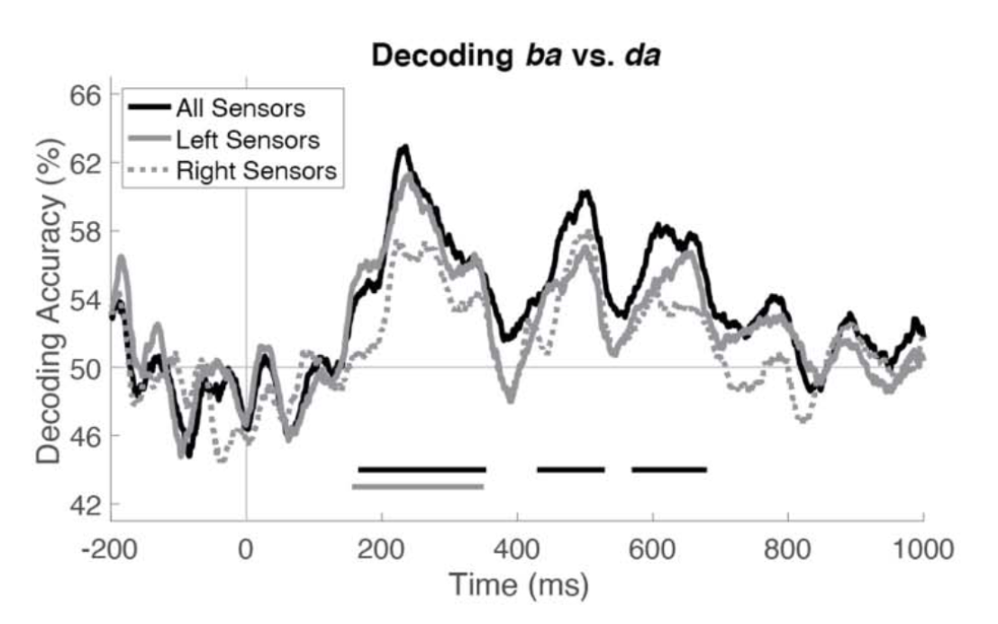
EEG Decoding for Semantic Processing
Can decode EEG for similar auditory stimuli (Beach et al., 2021)

Slide 7
Research Questions
For a bistable percept, does semantic priming influence EEG data?
Can we decode different perceptions of a bistable stimulus
Does encoding/decoding change over multiple repetitions?

Slide 8
Pilot Analysis
Can we decode the stable versions of each phrase
Collect preliminary data on who can hear both percepts
9/13 from the lab survey
If decoding successful, move to full experiment

Slide 9
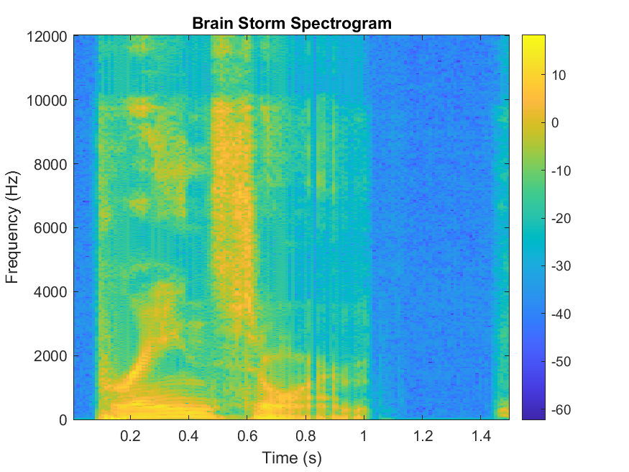
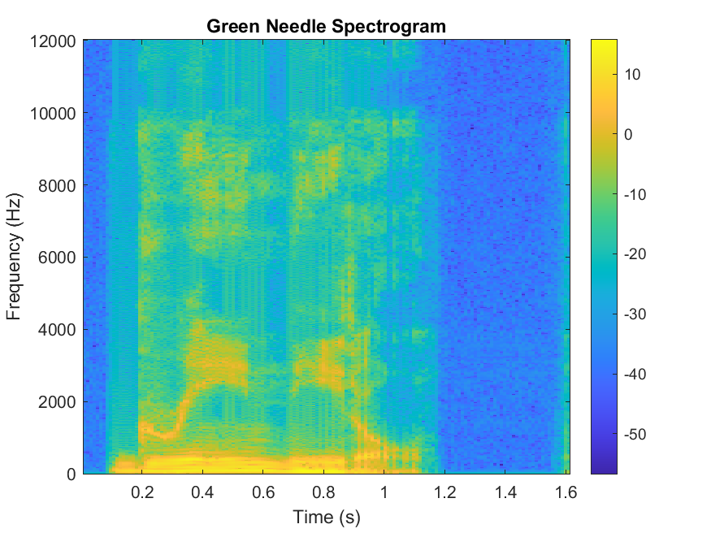
Synthesized audio

Slide 10
Comparing Spectograms

Slide 11
Pilot Collection
5x Target
(7500ms)
Variable Jitter
(0-200ms)
Fixation
(500ms)
6 Blocks of 40 trials:
2 Blocks Green Needle
2 Blocks Brainstorm
2 Blocks Mixed

Slide 12

Full Experiment
5x Target
(7500ms)
Variable Jitter
(0-200ms)
Prime
(500ms)
Fixation
(500ms)

Slide 13

Analysis Plan
Multivariate Temporal Response Function (mTRF)
Support Vector Machine Classification (SVM) of ERP Features

